Slide 1

Notes:
Introduce game and group members

Slide 2
Don’t you mean serial killers?
No, we don’t
It’s literally an evil spoon trying to kill a bowl of cereal
Avoidance is key
Use power-ups to stay alive
Don’t get discouraged!
Notes:
Playing as a friendly sentient bowl of cereal, avoid the evil, possessed spoon that wants to eat you
The aim of the game is to use varius obstacles and powerups located throughout each level to keep the spoon from catching the bowl of cereal
Puzzle/Chase hybrid
Some of the levels are difficult, don’t get discouraged
As game progresses, levels become more difficult
Must learn through repetition the best way to slow down the spoon

Slide 3
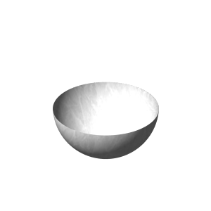
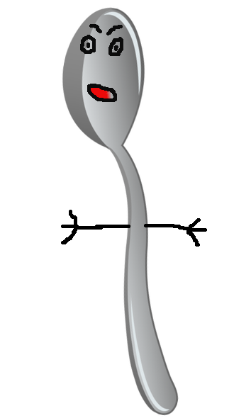
Main Characters

Slide 4
Challenges
Programing chase behavior
Artwork
Level design
Notes:
By far the most difficult aspect of this game has been programming a goldilocks chase behaviour
Not too easy, not too hard, but just right
Once it hits an obstacle, finding a route around it
Making the art work for the characters with little editing experience
We have improved dramatically since the beginning

Slide 5
Mechanics, Dynamics, and aesthetics
Top-down view
Obstacles slow down both players
Spills, obstructions,
Power-ups used to slow down spoon
Pacman-esque
Notes:
The player looks down from above on each level and has the freedom to move in any direction
When either the player or spoon collides with an obstacle their movement behavior is temporarily disabled
Player picks up power ups such as, ****, that when activated slow, freeze, disorient spoon
The gameplay is similar to pacman in that the player has the freedom to move in any direction as long as there is not an obstruction
Enemies follow the player and player must use powerups to avoid/disable enemy

Slide 6
How can we improve?
Meet face to face
More consistent work
Notes:
The biggest challenge facing our group is our differeing schedules
Because of this, it has been difficult to meet up in person
Can’t work in large blocks, break up work into small improvements each day
Spending all night on game is draining, creates unnecessary stress

Slide 7
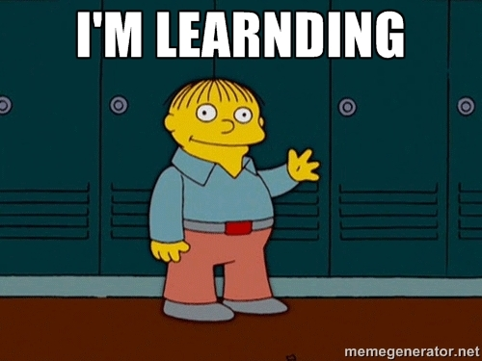
Lessons learned
Notes:
Don’t wait to the last minute, there will always be problems that come up
Communication is key!
Only one person can work at a time
Must let teammates know when you have pushed latest changes
Don’t spread yourself too thin
Waste time on unnecessary parts that will increase time
Defined roles
At the beginning we each tried to do a little of everything which led to confusion
We now have more defined roles aimed at each members strengths
Led to more consistent work

Slide 8
Questions?

Slide 9
Sources
http://metroatlantaairsoft.darkbb.com/t140-a-new-team-is-born

